Slide 1
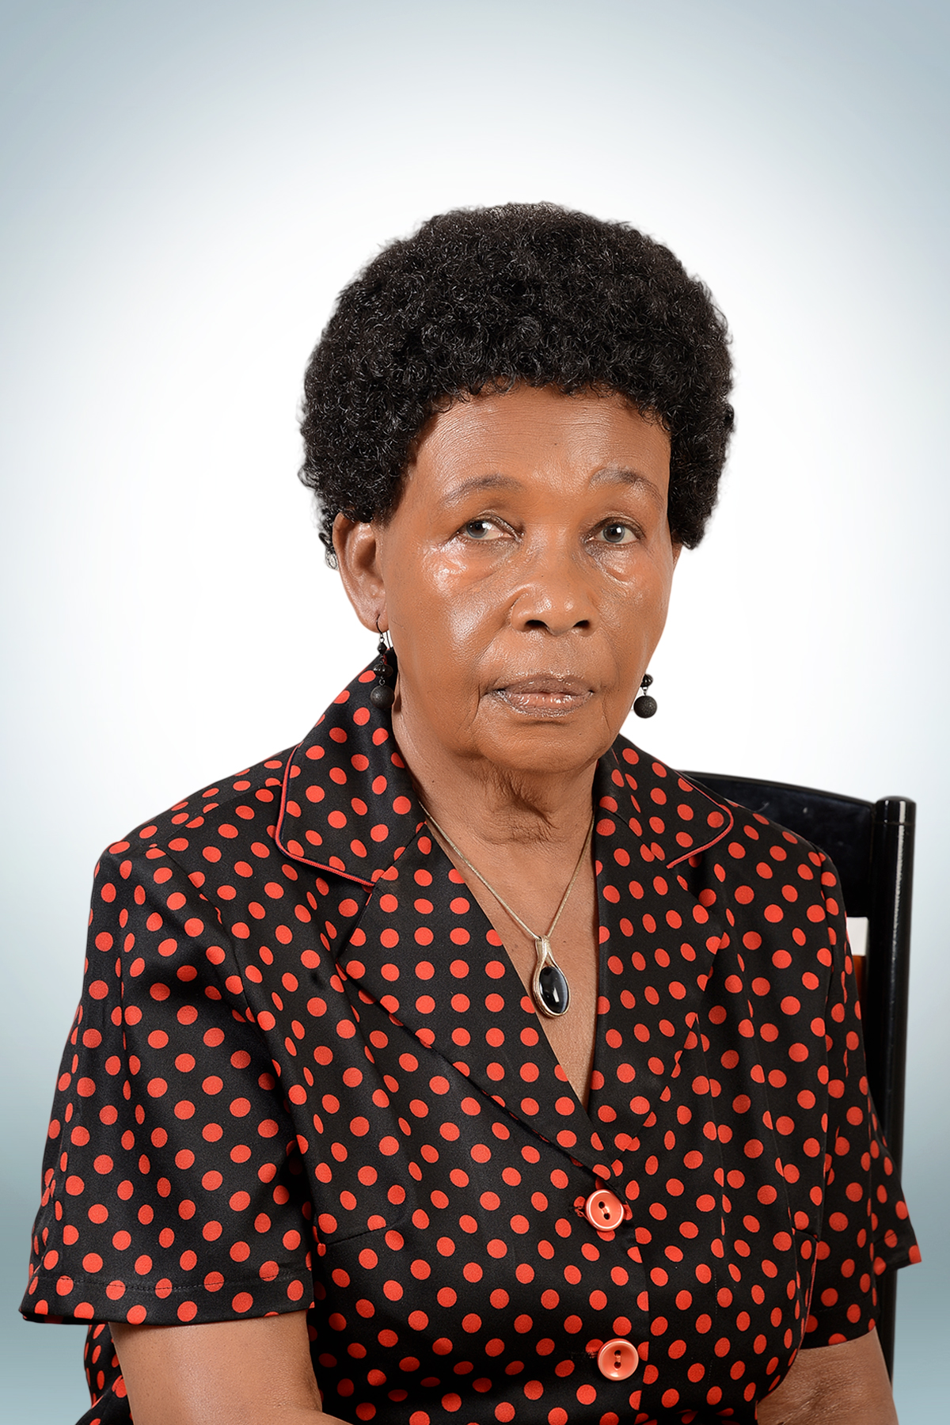
Understanding Viola Barungi’s Over my Dead Body

Slide 2
Biodata: Violet Barungi
74 years (18 December 1943)
Ugandan writer and editor
Worked as Production Officer at the East African Literature Bureau (1972–77)
Senior Book Production Officer at Uganda Literature Bureau (1978–94) and
editor at Femrite (1997-2007).

Slide 3
Her Works: Over My Dead Body
Address family relationships, gender issues and education of the girl child
Writer of Over My Dead Body, Bleeding Heart, and Award Winner,
Over My Dead Body won the British Council New Playwriting Award for Africa and the Middle East, 1997
Published by Illinois University Press, 2008, in the African Women PLAYWRIGHTS anthology

Slide 4
Over My Dead Body cont.
declared the Play of the Year by the Institute of Arts and Culture, University of Port Harcourt, Nigeria, 2016
performed by Indian Ensemble at the International Theatre Festival, in Kerala, India, 2016
made into a film by New Intentions Uganda, 2016

Slide 5
Core Theme
Over My Dead Body explores the cultural issue of early marriage girls and its consequences on the girl child who often becomes a liability to herself and society if the man dies or looses source of income
Boona, daughter of Mbogo wants to marry Tomusange: crital decision on pathway to progress (Education VS Marriage)

Slide 6
Early Marriage
MBOGO:
“If I had not left school prematurely to marry you and to take care of an unplanned family, I might have had a chance to realize my full potentials”
Cultural Issue: Marriage is seen as a communion between families NOT individuals,
Gender based Role Delineation

Slide 7
Early Marriage
Gerontocracy: “What an elder sees seating a child can not see it even if he is standing”
Honour: Family/ Pregnancy/Prostitution/Attempt to cover the dead
Double Standard (Discrimination against women: Polygmy)
Genital Mutilation: Fear of Pre-marital Sex/ Chastity

Slide 8
Place of the Woman
Stereotype:
“The place of the Woman is in the Kitchen”
Sasha:
“How can men ever respect us if we keep giving the impression that we can never ever do without them?”

Slide 9
Sub-Themes
Woman a Commodity (mother wanting to use daughter to escape from poverty)
Rural Urban Migration
Domestic violence (man and wife, daughter intervenes)
Greed (manipulation by all means) Mgoma and Nunu VS MBOGO and Sasha
also, Boona wants to even up with her rich classmates

Slide 10
Woman as Commodity
MGOMA
Oh, Mbogo, you don’t know how often I’ve prayed and dreamt of a chance like this, a chance to break free from the bonds of poverty and humiliation; of never having enough of anything, of longing for things that would never be all the time until your entire being is saturated with it. This must be God’s answer to my prayers... please, don’t say no, Mbogo, you can’t do this to me!

Slide 11
Rural Urban Migration
MBOGO
I wanted us to go to the village to farm our land, which we have in plenty. We would be much better off financially now, but no, you wouldn’t go. You wanted your city life. Well, this is the only part of the city we can afford to live in

Slide 12
Sub Themes
Get rich quick syndrome (sacrifice the happiness of their loved ones)
Disillusion about Education (education for what, functional education)
Depression by women as result of wrong choices
Reversal of Values/Disillusion: Village teacher as repository of knowledge
Hardwork Vs Opportunist

Slide 13
Others
Societal Pressure on Men: Man as provider

Slide 14
Critical Message
I wanted to have the fruits on top of the tree without going through the struggle of climbing the tree to get them
‘There’s no shortcut to success.’
It’s through one’s sweat and endeavor that one achieves one’s goal.

